Slide 1
Patient Survival Prediction
03/16/2022
Prepare for Data Mining Principles
By: Naibo(Ray) Hu, Weijia(Joyce) Wang, Wen Zhang, Jingwen Nan, Moxuan(Polly) Zheng, Rujue Du

Slide 2
Agenda
01
02
Business Problem
Data Profile & Quality
03
04
Data Processing
Exploratory Data Analysis (EDA)
05
06
Feature Engineering
Model Building & Evaluation
07
08
Conclusion
Lessons learned

Slide 3
Business Use Case
Business Problem | Data Profile & Quality | Data Processing | EDA | Feature Engineering |Model building & Evaluation | Conclusion| Lessons Learned
The predictors of in-hospital mortality for admitted patients remain poorly characterized. We aim to develop and validate a prediction model for all-cause in-hospital mortality among admitted patients, and identify factors that are most relevant to the ICU survival rate.
We hope that our analysis can provide clinical research and public health professionals with valuable insights, save lives by increasing patients’ survival rates, and ultimately bring a positive impact to the community.

Slide 4
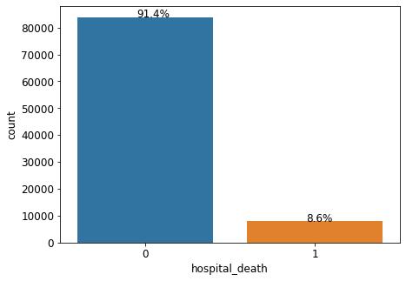
Data Profile
Business Problem | Data Profile & Quality | Data Processing | EDA | Feature Engineering |Model building & Evaluation | Conclusion| Lessons Learned
Name | Patient Survival Dataset
Dimensions | 85 variables 91, 713 rows
Data Type | Semi-structured
Data Size | 31.4 MB
Description | The dataset includes predictors for admitted patients in hospital
Source | Kaggle
Potential Problem: imbalanced response variable
91.4% of hospital_death is 0, and 8.6% of hospital_death is 1
Notes:
https://www.kaggle.com/mitishaagarwal/patient

Slide 5
Data Quality
Business Problem | Data Profile & Quality | Data Processing | EDA | Feature Engineering |Model building & Evaluation | Conclusion| Lessons Learned
Completeness
Validity
Uniqueness
Any missing values?
Does data match the rules?
Are there duplicate values?
Out of 85 variables, 75 of them have missing values. There are 288,046 missing values in total.
All fields are checked and formatted to be the appropriate data type in our database.
Each row in the dataset is unique.
Consistency
Timeliness
Accuracy
Consistent across various data stores?
Does data represent reality from required point in time?
Degree to which data represents reality
Dataset is stored in and sourced from Google Drive, so it is consistent for all users.
Dataset was created and uploaded in 2021, so the data is up-to-date.
Dataset contains patients’ various types of health data, which is objective.

Slide 6
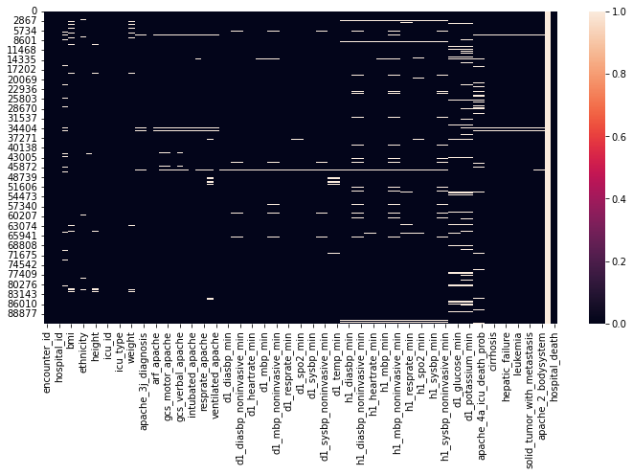

Handling Missing Values
Business Problem | Data Profile & Quality | Data Processing | EDA | Feature Engineering |Model building & Evaluation | Conclusion| Lessons Learned
Visualizing missing values with heatmap
For missing values in numeric variables, we use interpolation method.
There are 25 missing values in “gender” column, and we replaced them with the most frequent value, “M.”
Value counts in gender column

Slide 7
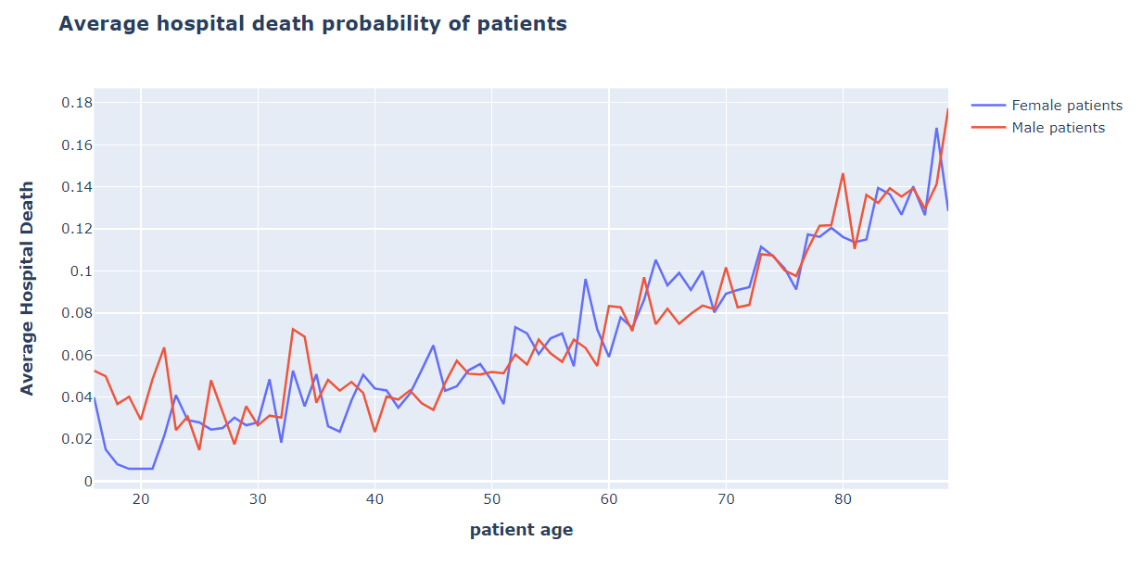
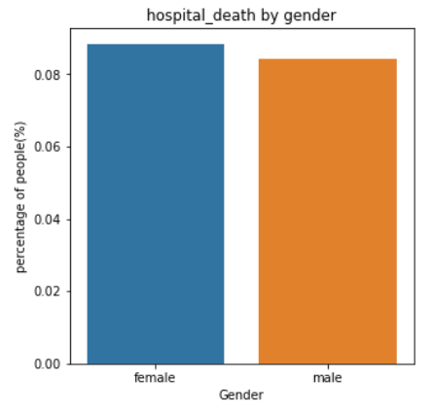
Hospital death is not related to gender
Business Problem | Data Profile & Quality | Data Processing | EDA | Feature Engineering |Model building & Evaluation | Conclusion| Lessons Learned
8.44% of male and 8.84% female died in hospital, which are roughly equal.
The mortality rate for male is much higher than that of female around age 15-25; this is probably due to male are more likely to engage in risky activities than female.
The mortality rates are similar for both men and women after age 25.
As patients get older, hospital death rate increases.

Slide 8
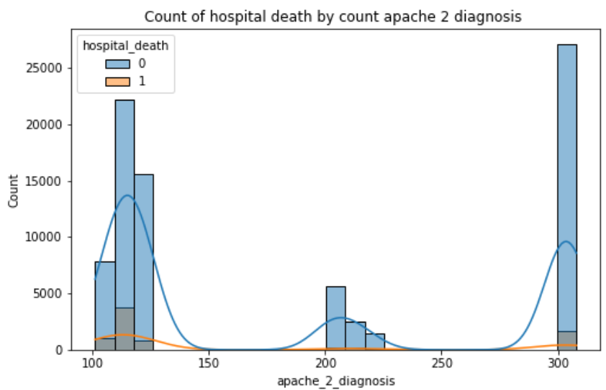
Apache score is not as predictive as expected, as low apache scores associate with high mortality rate
Business Problem | Data Profile & Quality | Data Processing | EDA | Feature Engineering |Model building & Evaluation | Conclusion | Lessons Learned
Insights:
Most patients are distributed around extreme apache scores.
Extremely high or low values indicate relative higher probabilities of deaths compared to mortality rate around score of 200, which is counterintuitive.
Intuition:
Patients with lower apache II scores might not be taken care of properly.
Since the apache II score only has 75% of accuracy, it is likely that the scores underestimate the severity of patients’ disease.
Explanation of Apache_2_diagnosis:
ICU scoring systems
Higher scores correspond to more severe disease and a higher risk of death

Slide 9
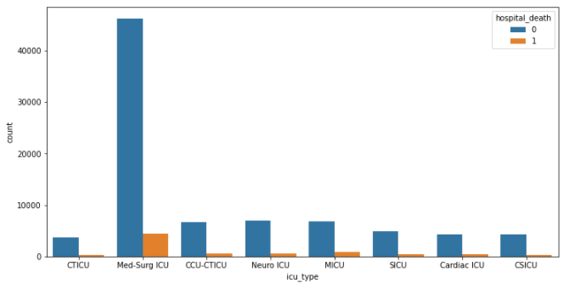
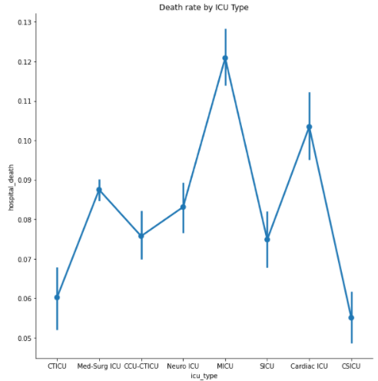
ICU types are associated with patients’ mortality rate
Business Problem | Data Profile & Quality | Data Processing | EDA | Feature Engineering |Model building & Evaluation | Conclusion | Lessons Learned
Death rate by ICU type
Number of patients by ICU type
Most patients are assigned to Med-Surg ICU. However, MICU(medical intensive care unit) has the highest death rate among all ICU types. This unit is a medical specialty that deals with seriously or critically ill patients who have, are at risk of, or are recovering from conditions that may be life-threatening.

Slide 10
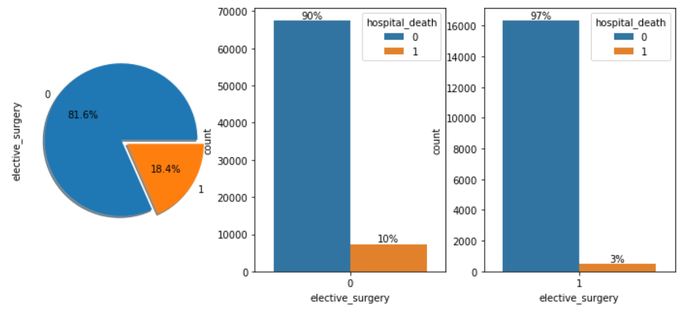
Receiving Elective Surgery is likely to reduce mortality rate
Business Problem | Data Profile & Quality | Data Processing | EDA | Feature Engineering |Model building & Evaluation | Conclusion | Lessons Learned
Insights:
The percentage of patients who were admitted for elective surgery was as low as 18.4%
However, as we find from the bar charts, patients who have received elective surgery had a lower mortality rate than those who did not.
Intuition:
Elective_surgery:
Even for mild symptoms, giving treatments earlier is likely to increase patients’ survival rate.
Whether the surgery can be scheduled in advance.
It may be a surgery you choose to have for a better quality of life, but not for a life-threatening condition.
Notes:
Elective surgery means that the surgery can be scheduled in advance. It may be a surgery you choose to have for a better quality of life, but not for a life-threatening condition.

Slide 11
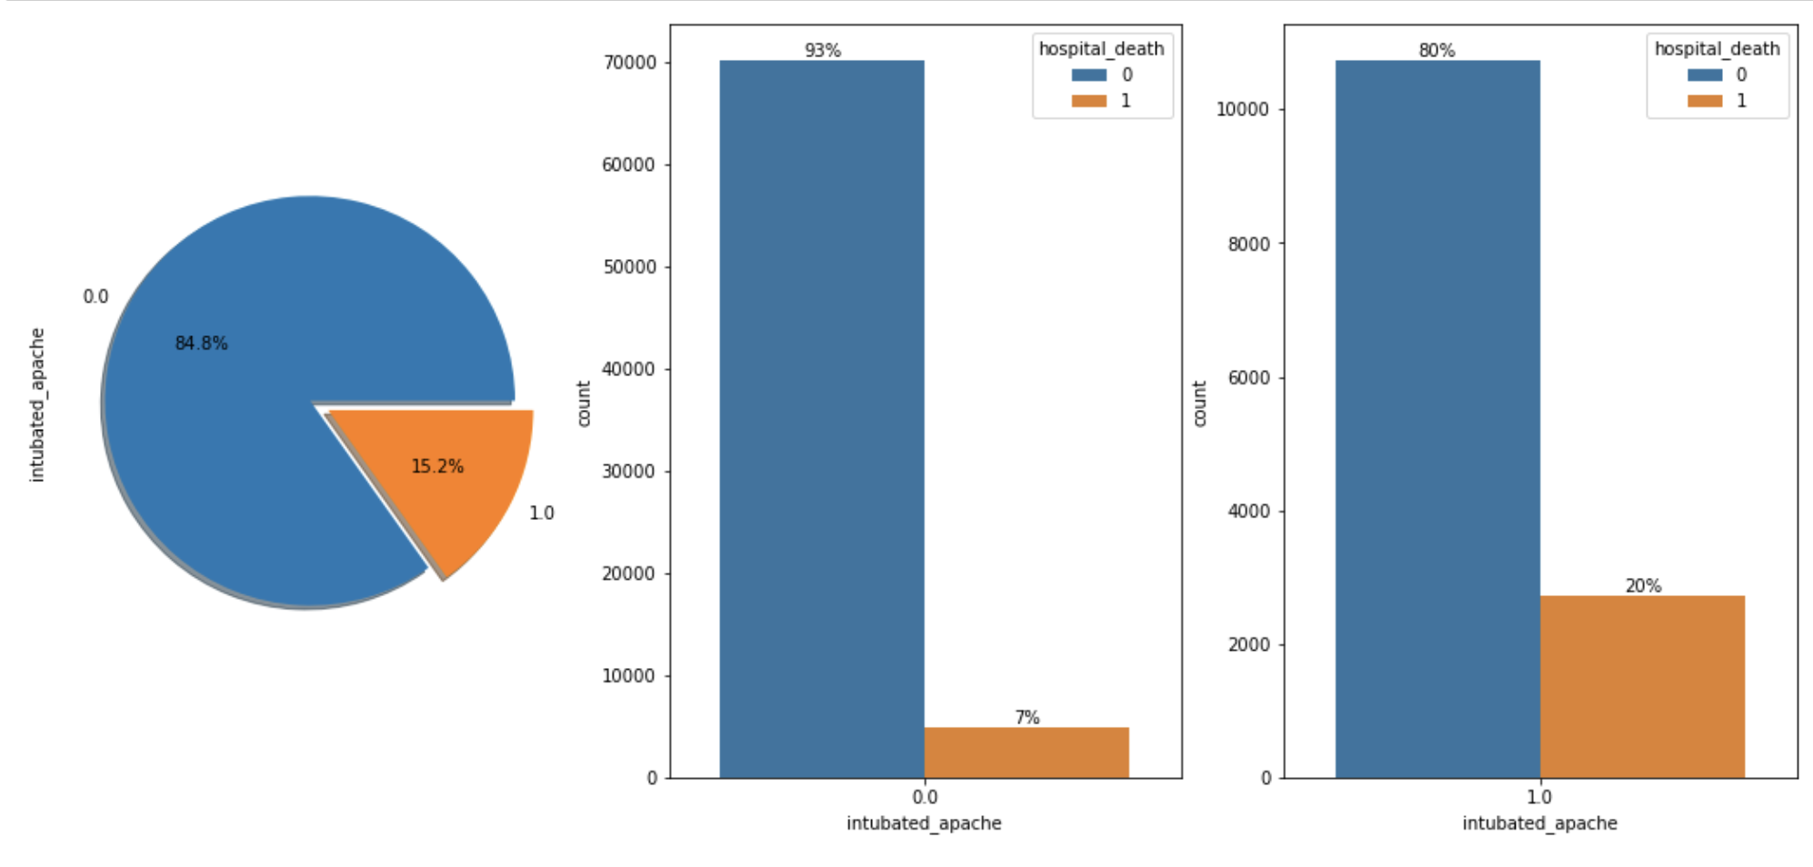
Intubated Apache is associated with patients’ mortality rate
Business Problem | Data Profile & Quality | Data Processing | EDA | Feature Engineering |Model building & Evaluation | Conclusion | Lessons Learned
Insights:
15% of the patients were intubated during the treatment, which means that they may have experienced respiratory failure or shock.
Our histograms show that the mortality rate is 20% for patients with intubated treatment, which is greater than the mortality rate of patients who were not intubated.
Intubated Apache:
Whether the patient was intubated at the time of the highest scoring arterial blood gas used in the oxygenation score

Slide 12
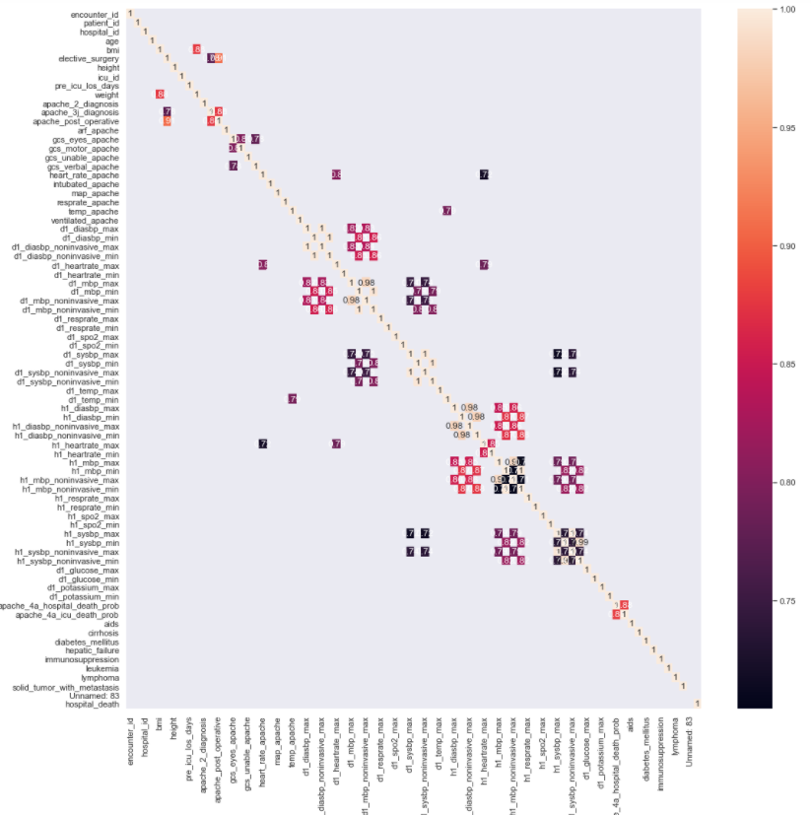
There is multicollinearity among numeric variables
Business Problem | Data Profile & Quality | Data Processing | EDA | Feature Engineering |Model building & Evaluation | Conclusion | Lessons Learned
Correlation Matrix Plot
Variables are considered to have collinearity if they have correlation values greater than 0.7.
There are 65 pairs of variables having correlation values greater than 0.7.
Thus, we decided to use PCA for dimension reduction and further reduce collinearity.

Slide 13
Encode categorical variables and drop unnecessary columns
Business Problem | Data Profile & Quality | Data Processing | EDA | Feature Engineering |Model building & Evaluation | Conclusion | Lessons Learned
Dummy Coding
gender
Drop columns
One Hot Encoding
Drop “encounter_id” and “patient_id”
ethnicity
icu_admit_source
icu_stay_type
icu_type
apache_3j_bodysystem
apache_2_bodysystem
121 variables
88,589 rows

Slide 14
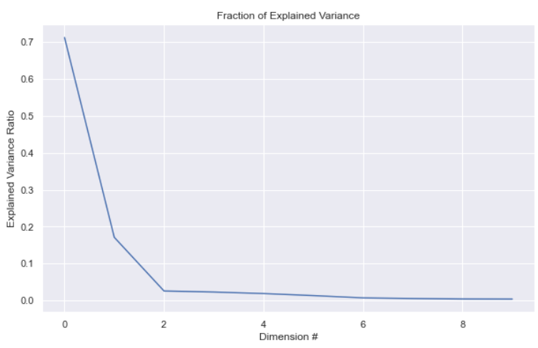
Principal Component Analysis (PCA)
Business Problem | Data Profile & Quality | Data Processing | EDA | Feature Engineering |Model building & Evaluation | Conclusion | Lessons Learned
Since we have 85 variables, and many of them have multicollinearity issue, we decided to eliminate noise through PCA.
From the PCA variance plot, we find that the first two components can explain roughly 85% of response variable. Thus, we decide to use first two components (0,1).
Based on PCA component plots, we end up selecting 32 significant variables (shown in Appendix)

Slide 15
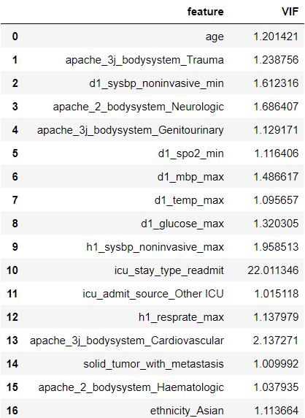
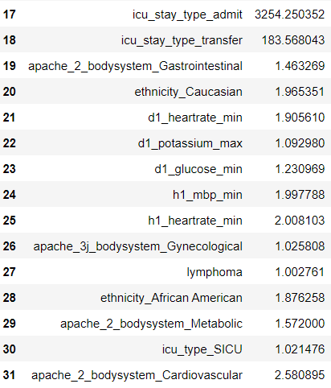
Utilize VIF to check multicollinearity for selected 32 predictors
Business Problem | Data Profile & Quality | Data Processing | EDA | Feature Engineering |Model building & Evaluation | Conclusion | Lessons Learned
“icu_stay_type_readmit,” “icu_stay_type_admit,” and “icu_stay_type_transfer” have VIF values greater than 5.
We decided to drop the three columns, and we ended up having 29 predictors

Slide 16
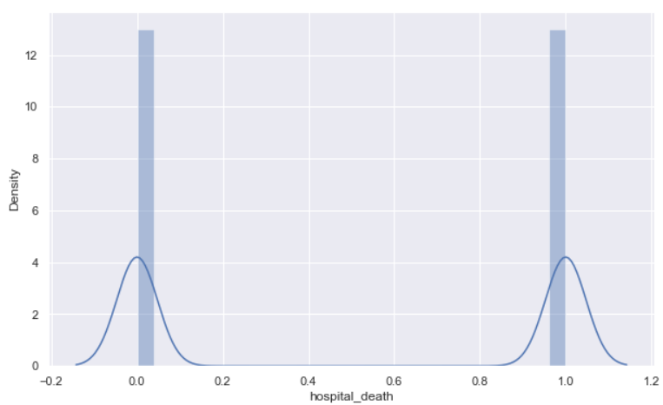
Utilized SMOTE Resampling method to oversample minority target variable
Business Problem | Data Profile & Quality | Data Processing | EDA | Feature Engineering |Model building & Evaluation | Conclusion | Lessons Learned
We split data into 80% train and 20% test, and we applied SMOTE to train data.
91.4% of hospital_death is 0, and 8.6% of hospital_death is 1 in training dataset
Distribution of target variable in train data after SMOTE
Hospital_death | Before SMOTE | After SMOTE
0 | 64,737 | 64,737
1 | 6,134 | 64,737

Slide 17
Random Forest is the optimal model
Business Problem | Data Profile & Quality | Data Processing | EDA | Feature Engineering |Model building & Evaluation | Conclusion | Lessons Learned
Patient Survival Prediction Result
We applied 10-fold cross validation to the train dataset. Then, we made predictions with the four models.
 | Training Accuracy | CV Accuracy | F1 Score | Precision Score | Recall Score
Logistic Regression | 0.748 | 0.744 | 0.748 | 0.747 | 0.750
Decision Tree | 0.878 | 0.878 | 0.878 | 0.868 | 0.892
Random Forest | 0.934 | 0.936 | 0.934 | 0.933 | 0.936
KNN | 0.875 | 0.880 | 0.875 | 0.800 | 0.998
Random Forest performed the best among the four models
No model has overfitting problem, as training accuracies roughly equal CV accuracies
Non-linear models are computationally complex and thus have higher accuracy values than the linear model
Notes:
Recall score is important

Slide 18
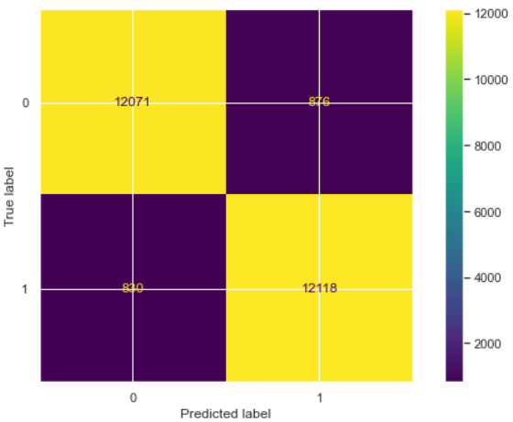
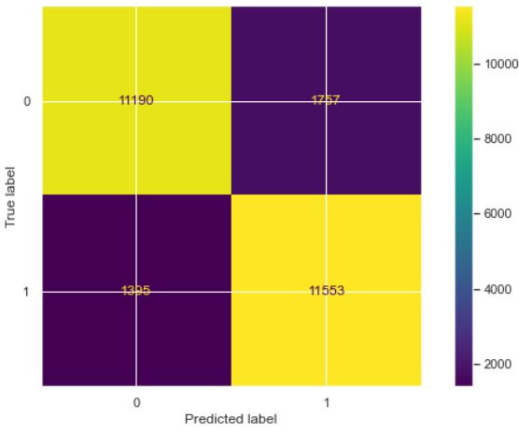
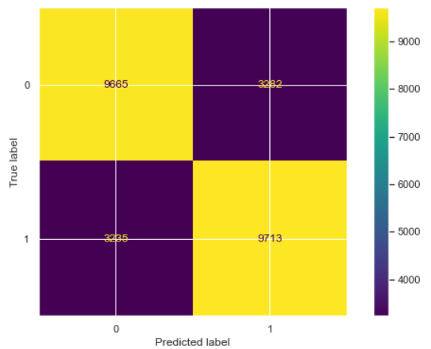
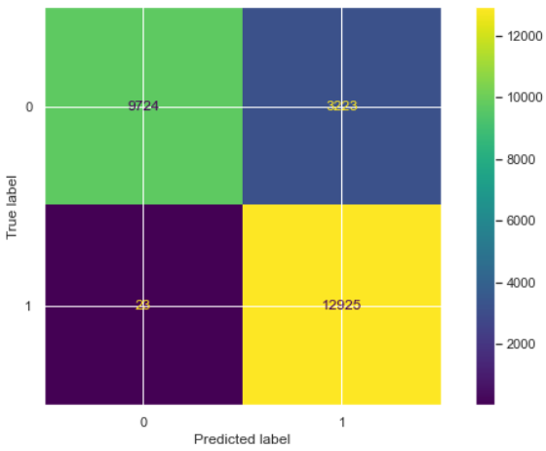
KNN generates the highest recall score (lowest false negative ratio)
Business Problem | Data Profile & Quality | Data Processing | EDA | Feature Engineering |Model building & Evaluation | Conclusion | Lessons Learned
Random Forest
Decision Tree
12071
876
11190
1757
Only 0.2% patients predicted to survive will actually die.
830
12118
1395
11553
Actual Label
Logistic Regression
KNN
Models | False Negative Ratio
Random Forest | 0.064
Decision Tree | 0.108
Logistic Regression | 0.250
KNN | 0.002
9665
3282
9724
3223
3235
9713
23
12925
Predicted Label

Slide 19
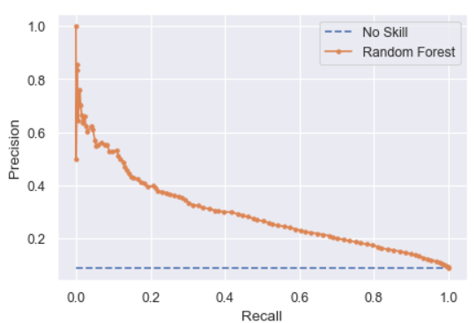
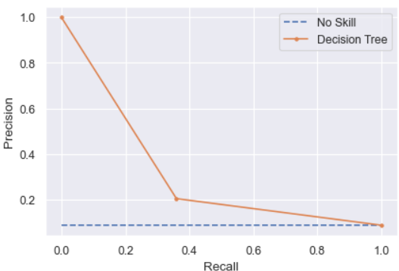
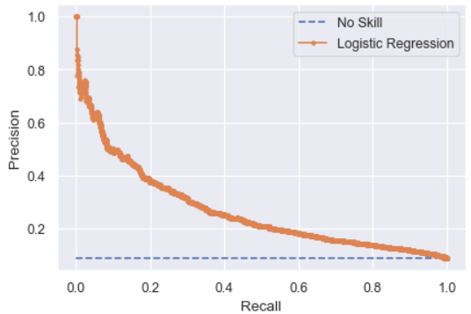
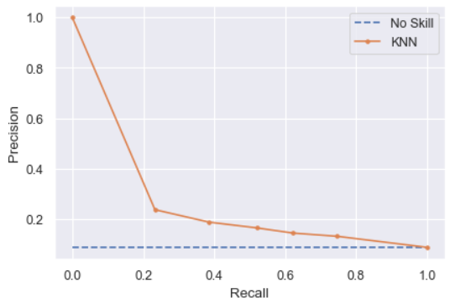
There is no ideal trade-off point between precision and recall
Business Problem | Data Profile & Quality | Data Processing | EDA | Feature Engineering |Model building & Evaluation | Conclusion | Lessons Learned
The four curves are far away from the upper right corner.
Thus, the trade-off between precision and recall is not ideal.

Slide 20
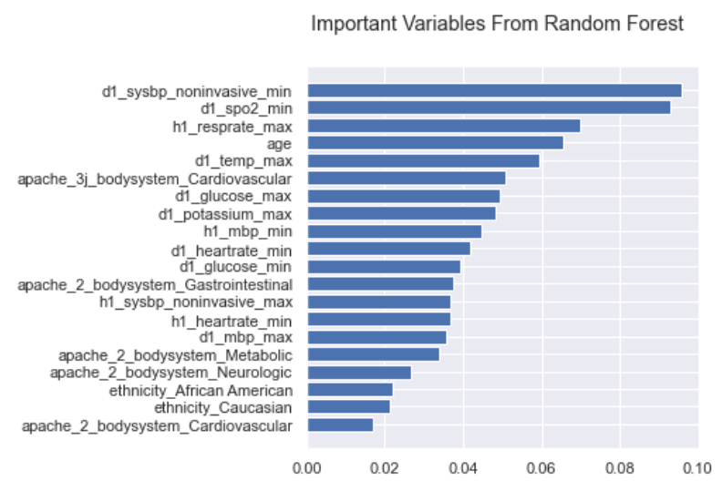
We identified top 20 significant variables from the random forest model
Business Problem | Data Profile & Quality | Data Processing | EDA | Feature Engineering |Model building & Evaluation | Conclusion | Lessons Learned
The top 5 important variables are “d1_sysbp_noninvasive_min”: , “d1_spo2_min”, “h1_resprate_max”, “age”, “d1_temp_max”, and they together explain 38.3% of the response variable.
These 5 variables take into consideration of blood pressure, oxygen saturation, respiratory rate, age, and temperature, all of which are vital to patients survival chance.

Slide 21
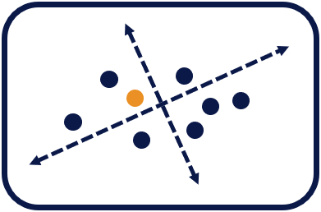

Conclusion
Business Problem | Data Profile & Quality | Data Processing | EDA | Feature Engineering |Model building & Evaluation | Conclusion | Lessons Learned
PCA has successfully reduced 85 variables to 32 variables, yet does not impact model performance.
Random forest is the optimal model with 93.16% prediction accuracy.
Nonlinear Models, such as random forest and decision tree, perform better than linear models, as they are more tolerant to complex data and are not affected by multicollinearity.
KNN has high recall score, which is 0.998.

Slide 22
Lessons Learned
Business Problem | Data Profile & Quality | Data Processing | EDA | Feature Engineering |Model building & Evaluation | Conclusion | Lessons Learned
Business Problem | Data Profile & Quality | Data Processing | EDA | Feature Engineering |Model building & Evaluation | Conclusion | Lessons Learned
02
We impute numeric missing values with linear interpolation. However, this method is not precise when we do not have linear data. In the future, we can use machine learning algorithms to predict missing values.
01
Some trends identified from EDA do not align with feature importances from random forest model.
For example, from EDA, we thought that ICU types and elective surgery are strongly associated with patient mortality rate. However, the ICU type is not in the list of top 20 important variables generated from the random forest model.
This result shows that physiological indicators such as blood pressure, body temperature directly impact patients mortality.
03
Since logistic regression does not perform well with post PCA data. It is possible that we do not select enough variables. Thus, we can consider applying lasso, ridge, and elastic net regularization techniques on pre PCA data.
Notes:
While generating synthetic examples, SMOTE does not take into consideration neighboring examples can be from other classes. This can increase the overlapping of classes and can introduce additional noise.
Lesson Learned:
PCA is a good method to deal with dimension reduction
PCA is a good way to process feature selection based on loadings.
Random Forest works well with health related data, and avoid problems of overfitting and underfitting while provide great accuracy. RF is not computational complex, and could provide with attributes importance for further analysis.
SMOTE is a powerful solution for imbalanced data.
KNN is computational complexed while it did not provide highest accuracy. Logistic regression is easy to implement, but it might not be complex enough to provide the best prediction.

Slide 23
Thanks!

Slide 24
Reference
https://sdsclub.com/how-to-train-and-test-data-like-a-pro/
https://machinelearningmastery.com/smote-oversampling-for-imbalanced-classification/
https://scikit-learn.org/stable/modules/generated/sklearn.ensemble.RandomForestClassifier.html
https://www.geeksforgeeks.org/difference-between-pca-vs-t-sne/
https://www.ibm.com/cloud/learn/random-forest
https://dhirajkumarblog.medium.com/top-4-advantages-and-disadvantages-of-support-vector-machine-or-svm-a3c06a2b107
https://nurse.org/articles/hospital-unit-acronyms/#:~:text=MICU%20stands%20for%20medical%20intensive,gastrointestinal%20problems%2C%20and%20blood%20infections.
https://www.hopkinsmedicine.org/health/treatment-tests-and-therapies/types-of-surgery
https://www.mountsinai.org/health-library/tests/blood-gases
https://www.ncbi.nlm.nih.gov/pmc/articles/PMC3237146/

Slide 25
Appendix

Slide 26
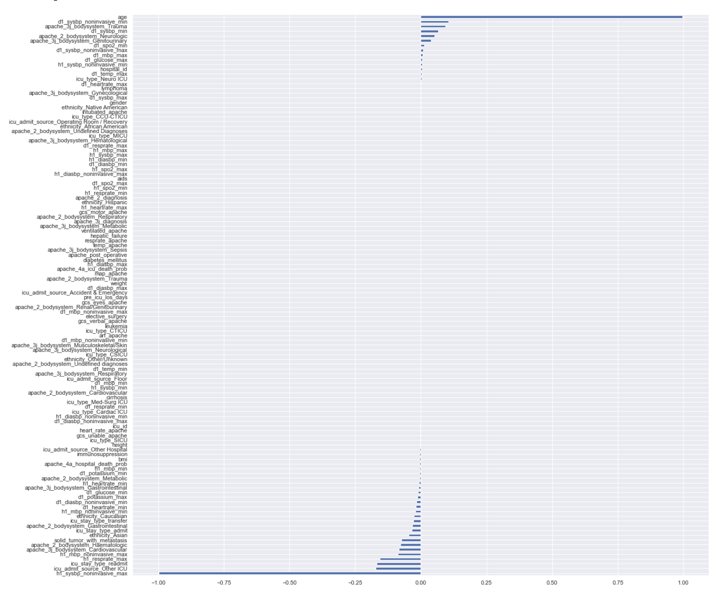
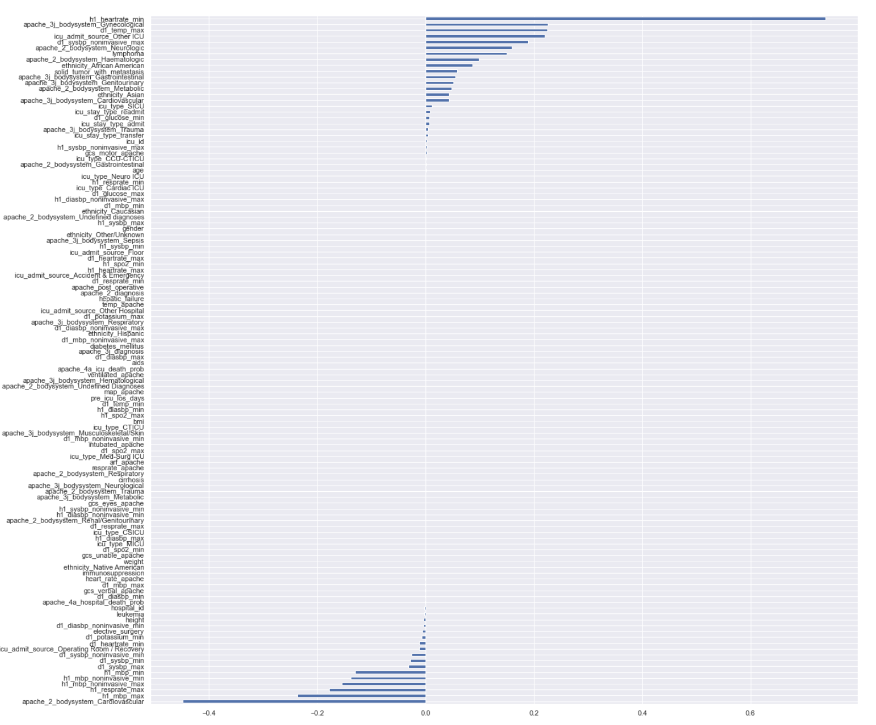
PCA 1 Loadings
PCA 2 Loadings

Slide 27
Selected 32 significant variables from PCA components
'age', 'apache_3j_bodysystem_Trauma', 'd1_sysbp_noninvasive_min', 'apache_2_bodysystem_Neurologic', 'apache_3j_bodysystem_Genitourinary', 'd1_spo2_min', 'd1_mbp_max', 'd1_temp_max', 'd1_glucose_max', 'h1_sysbp_noninvasive_max', 'icu_stay_type_readmit', 'icu_admit_source_Other ICU', 'h1_resprate_max', 'apache_3j_bodysystem_Cardiovascular', 'solid_tumor_with_metastasis', 'apache_2_bodysystem_Haematologic', 'ethnicity_Asian', 'icu_stay_type_admit', 'icu_stay_type_transfer',
'apache_2_bodysystem_Gastrointestinal',
'ethnicity_Caucasian', 'd1_heartrate_min', 'd1_potassium_max',
'd1_glucose_min', 'h1_mbp_min', 'h1_heartrate_min',
'apache_3j_bodysystem_Gynecological', 'lymphoma',
'ethnicity_African American', 'apache_2_bodysystem_Metabolic',
'icu_type_SICU', 'apache_2_bodysystem_Cardiovascular'

Slide 28



Models Used
Business Problem | Data Profile & Quality | Data Processing | EDA | Feature Engineering |Model building & Evaluation | Conclusion | Lessons Learned
Logistic Regression
Decision Tree
Random Forest
KNN
A statistical analysis method to predict a binary outcome based on prior observations of dataset
A supervised learning model composed of a set of conditions and leaves organized hierarchically
A classification algorithm consisting of many decisions trees.
Uses bagging and feature randomness to create an uncorrelated forest of trees
A type of classification where the function is only approximated locally and all computation is deferred until function evaluation.

